Slide 1

Welcome
Department of Computer Science & Engineering
Software Development Lab III
CSE-2200

Slide 2
Project Name: Care_Zone
Project Members:
Mushfiqur Rashid Khan(Prottoy)
ID: 15-01-04-086
Anika Rahman (Ananna)
ID: 16-02-04-012

Slide 3

Overview
User must have his own account to see the catagories
Various advices to maintain a sound health
Benefits of different types of meditations
The way of meditation for the beginners
Body Mass Index(BMI) calculations
Various advices to maintain a balanced diet
Various types of common diseases

Slide 4
Reason of Project Selection
Many of us aren’t conscious of our health
People don’t know about their balanced diet
Many people are not aware of some common diseases
Most of us don’t focus on different types of meditations
It isn’t too much easy to find out the body mass index

Slide 5
Project Requirements
Front End Design: Extensive Markup Language(XML)
Back End Design/Coding: Java
Software Requirement: Android Studio 3.1.0
Hardware Requirement: Windows 10 Operating System
Database: SQLite
External Resource: Internet

Slide 6
Project Goals
To make people conscious of their health with some tips
To inform people about their balanced diet
To make people aware of some common diseases
To inform people about different types of meditations
To calculate the body mass index in the easiest way

Slide 7
Features
Account Creation and Log in
Health Tips and Balanced Diet
Meditations
BMI Calculation
Different Diseases
Home Remedies

Slide 8
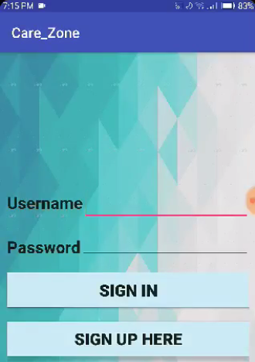
Feature Description
Account Creation
User must log in to visit this application, if he/she has any account. Otherwise, he/she must create an account by signing up.

Slide 9
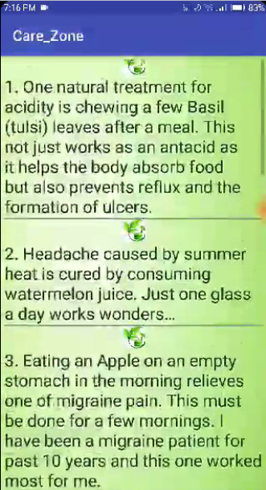
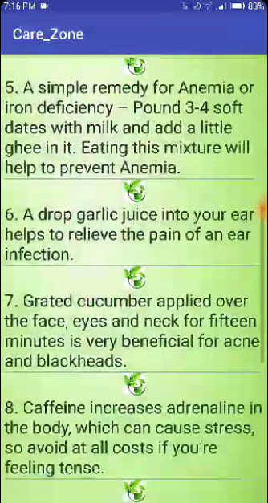
Feature Description
Home Remedies
Some home remedies for the users by taking specific foods at the right time and maintaining some specific rules for health.

Slide 10
Feature Description
Home Remedies
Chewing a few Basil leaves after a meal
Consuming a glass of watermelon juice in a day
Eating an Apple on an empty stomach
Mix two teaspoons of honey with equal quantity of ginger juice
3-4 soft dates with milk and add a little ghee

Slide 11
Feature Description
Home Remedies
A drop garlic juice in ear
Grated cucumber applied over the face
Avoid Caffeine
Having pomegranate’s juice daily
Muscle lengthening exercises

Slide 12
Feature Description
Home Remedies
Some home remedies for the users by taking specific foods at the right time and maintaining some specific rules for health.

Slide 13
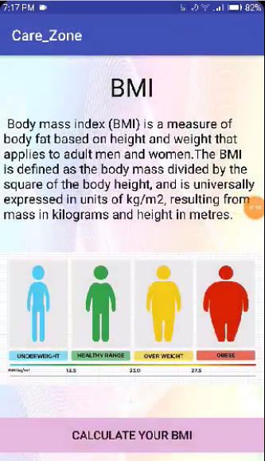
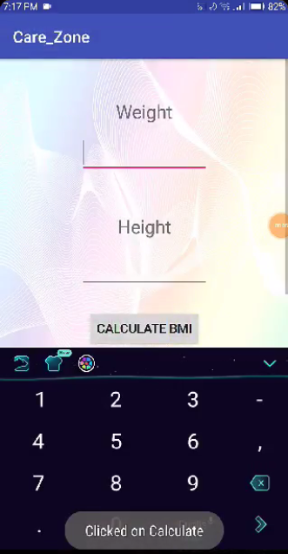
Feature Description
BMI Calculation
By inserting height and weight, body mass index will be calculated.

Slide 14
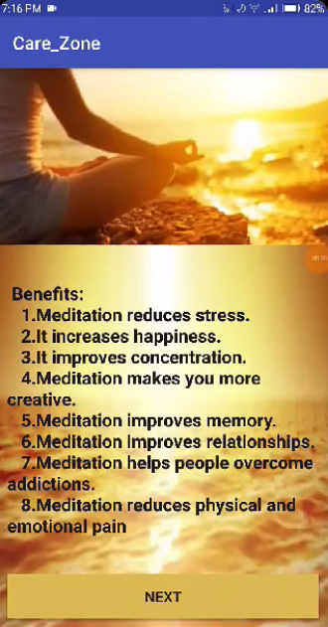
Feature Description
Meditation
The very much important way of maintaining a sound mind and a sound health is meditation. There are so many benefits of meditation.

Slide 15
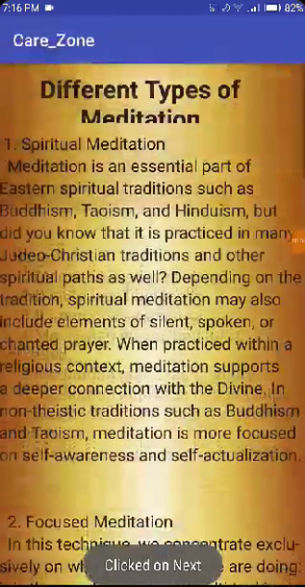

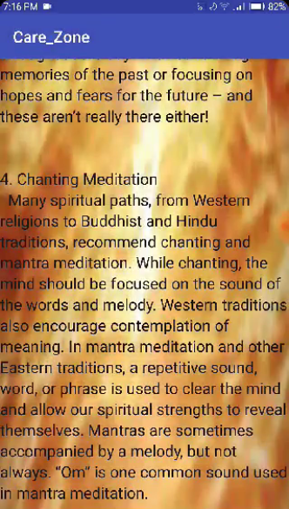
Feature Description
Different types of Meditations
There are different types of meditations described in this application. The meditations are different in their ways and usefulness.

Slide 16
Feature Description
Different types of Meditations
Spiritual Meditation
Focused Meditation
Visualization Meditation
Chanting Meditation

Slide 17
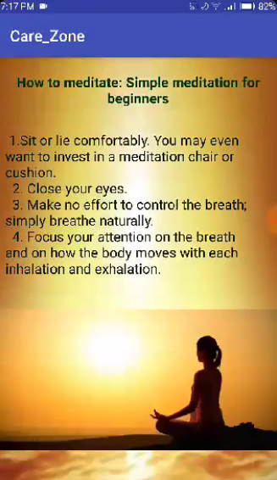
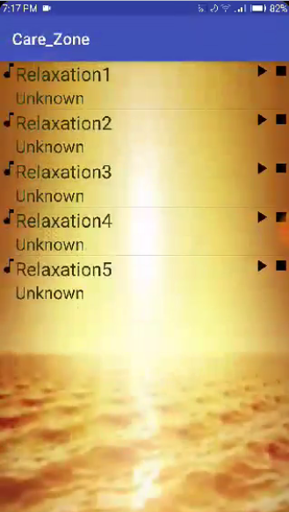
Feature Description
The ways of meditation
The most important way of meditation for the beginners which is the simplest way and easiest way of meditation with specific music.

Slide 18
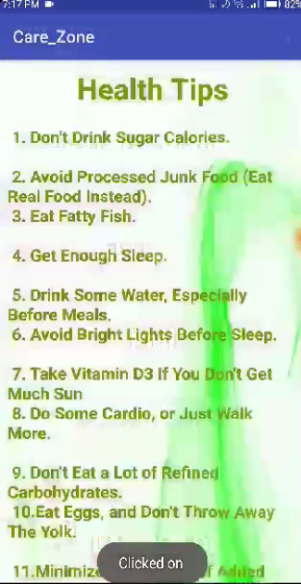
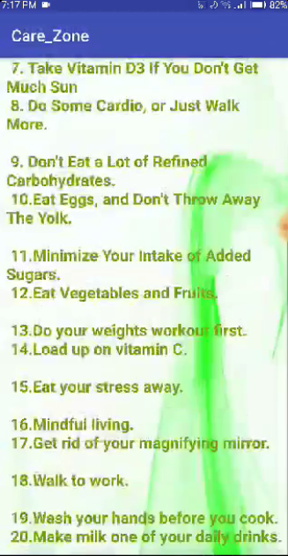
Feature Description
Health Tips
The are some important tips maintaining a sound mind and a sound health which are too much beneficial for health.

Slide 19
Feature Description
Health Tips
Avoid drinking sugar calories
Avoid junk food
Eating fatty fish
Get enough sleep
Drinking water
Taking Vitamin D3
Avoiding bright lights

Slide 20
Feature Description
Health Tips
Walking More
Avoid eating a lot
Eating eggs without yolk
Eating vegetables and fruits
Mindful living
Washing hands before cooking
Loading up on Vitamin C

Slide 21
Feature Description
Health Tips
Minimizing intake of adding sugar
Doing weights workout first
Get rid of magnifying mirror
Eating stress away
Walking to work
Making milk one of your daily drink

Slide 22
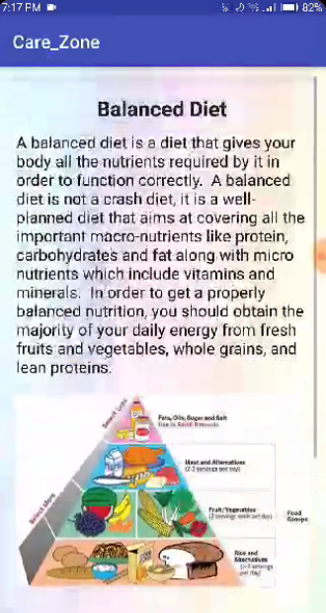
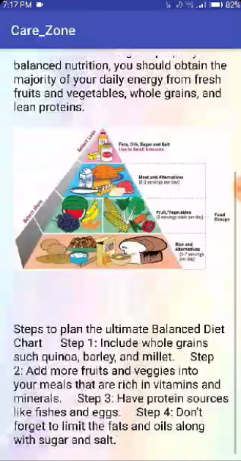
Feature Description
Balanced Diet
A balanced diet will give your body all kinds of nutrition required by it to work properly. It is too much necessary for our body to work correctly.

Slide 23
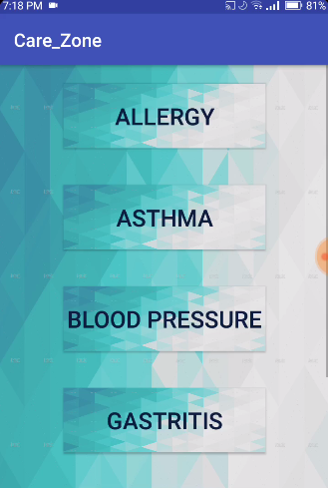
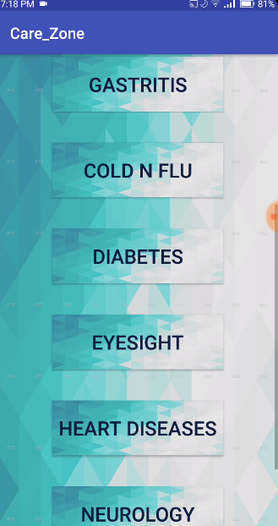
Feature Description
Diseases
There are different types of diseases with symptoms for breaking the rules and an undisciplined life. It is prevented by specific drugs.

Slide 24
Feature Description
Diseases
Allergy
Diseases
Asthma
Diabetes
Cold N Flu
Blood Pressure
Gastric

Slide 25
Feature Description
Incomplete Feature
Nearby Doctors
This feature can’t be possible to complete in this project. Because it needs the API key to maintain the google map. There is no API key for us in this project. So, this feature is impossible to complete at this moment for us. But we’ll try our best to complete this feature in our further improvement of this project.

Slide 26
Feature Description
Conclusion
That’s all about the project we have done so far. We have completed this project before the final submission as possible as we can. We hope, this project will help the users and it will be helpful for the personal health care. Thank you so much.

Slide 27
Any Questions???

Slide 28
Thank you!!

